Slide 1
Reviews and Inspections
CSE 435

Slide 2
Optimal Review
An 'optimal' review will:
  find all important defects
  give all reviewers deep insight into the code
  enable the author to improve the code
  all with least possible effort
So, in other words, objective of a review is:
  Optimal quality improvement
  Optimal knowledge acquisition
  With lowest possible cost

Slide 3
What is review?
As defined by IEEE (1990), a review process is:
“A process or meeting during which a work product, or set of work products, is presented to project personnel, managers, users, customers, or other interested parties for comment or approval.”

Slide 4
Objectives
■ To detect analysis and design errors as well as subjects where corrections, changes and completions are required with respect to the original specifications and approved changes.
■ To identify new risks likely to affect completion of the project.
■ To locate deviations from templates and style, procedures and conventions. Correction of these deviations is expected to contribute to improved communication and coordination resulting from greater uniformity of methods and documentation style.
■ To approve the analysis or design product. Approval allows the team to continue to the next development phase.

Slide 5
What reviews do that testing doesn't
1. Reviews improve schedule predictability.
2. Reviews reduce rework.
3. Reviews are pro-active tests.
  Find errors not possible through testing, such as Errors of Omission (i.e. unimplemented requirement)
4. Reviews are training.
  Domain, corporate standards, group.
R
e
v
s
Req
R
Design
R
Code
R
Test
N
o
R
e
v
s
.
Req
Design
Code
Test

Slide 6
Methods vs. Optimality
Walkthroughs:
  Cost: very low
  Knowledge transfer: undependable
  Quality improvement: undependable
Functional Technical Reviews/ Design Reviews:
  Cost: moderate
  Knowledge transfer: better
  Quality improvement: at least some
  conducted by senior personnel or
  outside experts
  Minimal overhead
  Developer training
  Little/no preparation, No formal process, No measurement
  Defect discovery, Ambiguity resolution, Training
  Some formal process, Multiple stages, Wide range of discussion

Slide 7
Inspection:
  Cost: high (and not necessarily ‘least possible’)
  Knowledge transfer: almost guaranteed.
  Quality improvement: almost guaranteed
  done by peers
  Detect errors, adherence to standards
  Detect and remove all defects efficiently and effectively.
  Very formal process, Quality Measurement, Verification

Slide 8
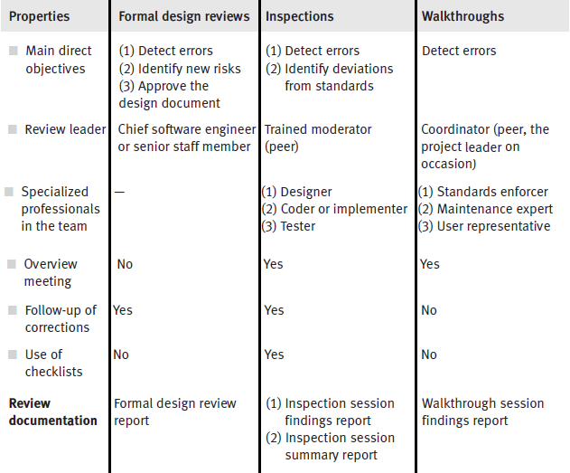

Slide 9
Different kinds of review
Development Method
Non-Cleanroom
Cleanroom
Verification-
inFTR
FTR
based
Inspection
Tool-Based
Manual
(Dyer92)
Walkthrough
(Yourdon89)
Code
Active
Code
Software
Reading
Design
Inspection
Review
(McConnell93)
Reviews
(Fagan76)
(Humphrey90)
(Parnas85)
Inspection
FTArm
(Gilb93)
(Johnson94)
Scrutiny
TekInspect
(Gintell93)
2-Person
N-Fold
CAIS
ICICLE
Phased Insp.
(Knight93)
Inspection
Inspection
(Mashayekhi94)
(Brothers90)
(Bisant89)
(Martin90)
Notes:
The Cleanroom approach combines mathematical-based methods of software specification, design and correctness
verification with statistical, usage-based testing to certify software fitness for use.
Therefore the goals in this method is to reduce the failures found during testing
by enabling good and correct designs that avoid rework.
Most designs pass through detailed specifications and modeling which are evaluated and proved for correctness using formal methods

Slide 10
Inspection: the most formal review
Choose team, materials, dates.
Planning
Present product, process, goals.
Orientation
Check product, note issues.
Preparation
Review Meeting
Consolidate issues.
Rework
Correct defects.
Verify
Ensure rework was done correctly

Slide 11
Planning
  Gather review package: work product, checklists, references, and data sheets.
  Form inspection team.
  Determine dates for meetings.

Slide 12
Orientation
  Author provides overview.
  Reviewers obtain review package.
  Preparation goals established.
  Reviewers commit to participate.

Slide 13
Preparation
  Find maximum number of non-minor issues.
Example Issue Classification
Critical
  Defects that may cause the system to hang, crash, produce incorrect results or behavior, or corrupt user data. No known work-arounds.
Severe
  Defects that cause incorrect results or behavior with known work-arounds. Large and/or important areas of the system is affected.
Moderate
  Defects that affect limited areas of functionality that can either be worked around or ignored
Minor
  Defects that can be overlooked with no loss of functionality.

Slide 14
Review Meeting
  Create consolidated, comprehensive listing of non-minor issues.
  Provide opportunity for group synergy.
  Improve reviewing skill by observing others.
  Create shared knowledge of work product.

Slide 15
Rework
  Assess each issue, determine if it is a defect, and remove it if necessary.
  Produce written disposition of non-minor issue.
  Resolve minor issues as necessary.

Slide 16
Verify
  Assess the (reworked) work product quality.
  Assess the inspection process.
  Pass or fail the work product.

Slide 17
Inspection Process in a nutshell
pre-meeting
    read the document ahead of time
meeting
    author presents overview
    review team asks questions and express opinions
after meeting
    scribe prepares summary
    team approves summary
    follow up

Slide 18
Inspection Guidelines
Review the Product, not the person!
Find errors, don't try to solve them!
Keep Records
    Take written notes.
    Review your earlier reviews.
Allocate resources and schedule time for FTRs.
    3 to 5 people
    Conduct training for reviewers
Keep it short
    limit debate and rebuttal
      Set an agenda and keep it.
    no more than two hours preparation
      small portions only
      narrow focus increases likelihood of finding an error
    meeting duration less than two hours

Slide 19
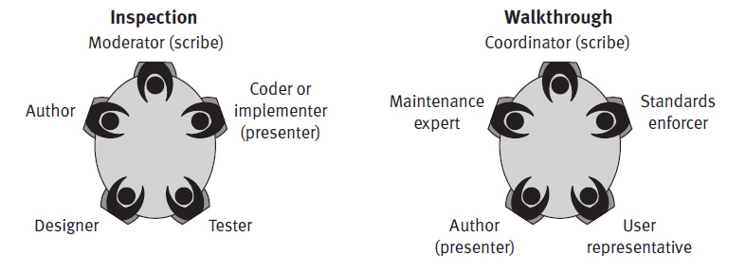
Inspection and Walkthrough

Slide 20
Inspection Walkthrough
Planning
Planning
Orientation
Preparation
Preparation
Review Meeting
Walkthrough Session
Rework
Report
Verify

Slide 21
Formal Reviews (FTR/ DR)
Reviewers should be senior personnel and/or outside experts
Outcome:
    approve
    approve pending changes
    reject
Review Leader should not be Project Leader
Usually done at the end of the phase.
    very appropriate for SRS and Design
    sometimes appropriate for code

